Slide 1
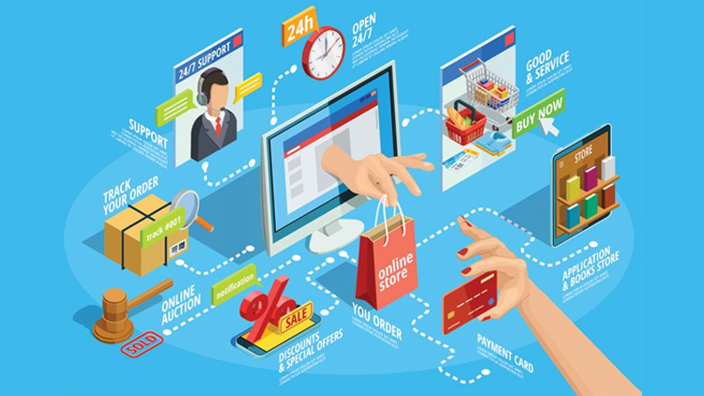
E-Commerce Application on IBM Cloud Foundry
Submitted By,
SANDIP MONDAL
SRINITHESH
SURYA
SUDURDEVA
Tamilselvan

Slide 2
Problem Statement
In this part you will need to understand the problem statement and create a document on what have you understood and how will you proceed ahead with solving the problem.
Please think on a design and present in form of a document.

Slide 3
Abstract
The Cloud-Enabled E-Commerce Platform on IBM Cloud Foundry is a robust and scalable solution designed to empower businesses in the digital marketplace. Leveraging the capabilities of IBM's Cloud Foundry PaaS, this application provides a seamless and secure environment for hosting online stores, managing inventory, processing transactions, and engaging customers.

Slide 4
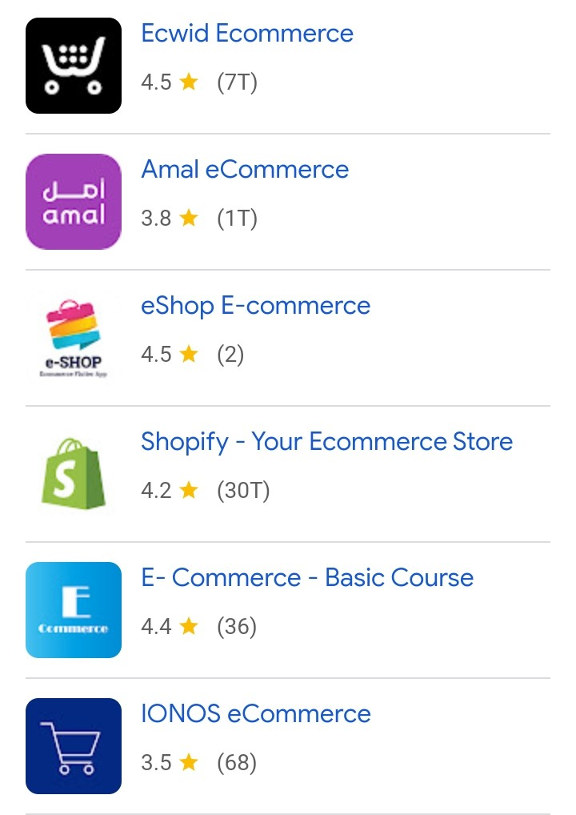
Existing E-Commerce Application

Slide 5
Problem Definition and Design Thinking

Slide 6
Design Thinking
Problem Definition:
The project is to build an artisanal e-commerce platform using IBM Cloud Foundry. The goal is to connect skilled artisans with a global audience, showcasing their handmade products and providing features like secure shopping carts, payment gateways, and an intuitive checkout process. Implementing necessary features, and ensuring a seamless user experience.

Slide 7
Design Thinking
Platform Design:
Design a platform layout with section for product categories, individual product pages, shopping cart, checkout, and payment.

Slide 8
Design Thinking
Product Showcase:
Create a database to store product information such as images, descriptions, prices, and categories.

Slide 9
Design Thinking
User Authentication:
Implement user registration and authentication features to enable artisans and customers to access the platform.

Slide 10
Design Thinking
Shopping Cart and Checkout:
Design and develop the shopping cart functionality and a smooth checkout process.

Slide 11
Design Thinking
Payment Integration:
Integrate secure payment gateways to facilitate transactions.

Slide 12
Design Thinking
User Experience:
Focus on providing an intuitive and visually appealing user experience for both artisans and customers.

Slide 13
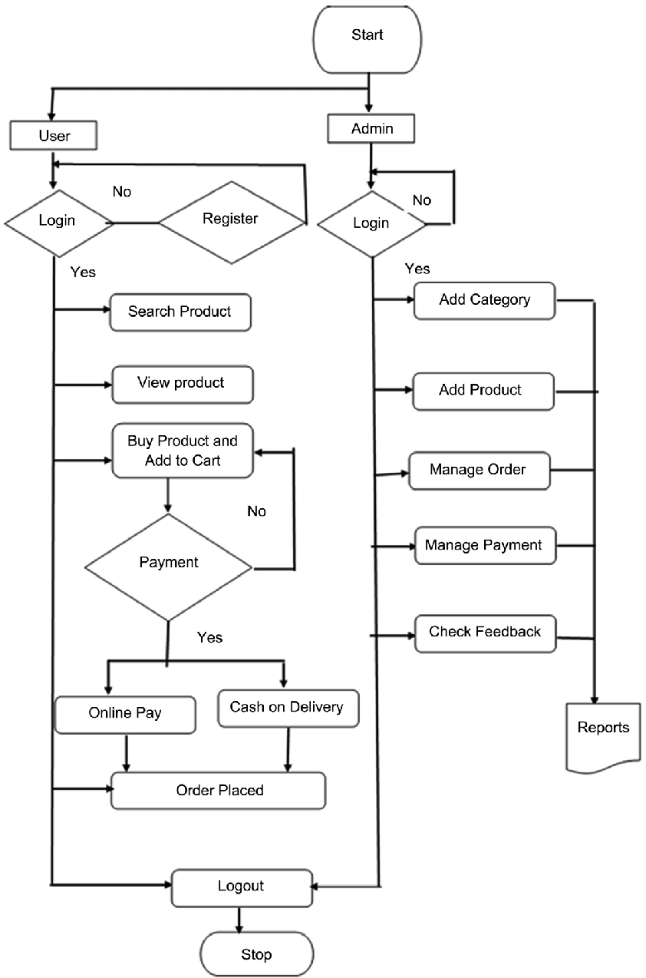
Flow Diagram for E-commerce Applications

Slide 14
Key Features of E-commerce Application
Scalability and Flexibility
Multi-Channel Support
Secure Payment Processing
Inventory Management and Order Fulfillment
Personalized Customer Experiences
Integration Capabilities
Monitoring and Analytics
High Availability and Disaster Recovery
Compliance and Data Protection
Developer-Friendly Environment

Slide 15
Benefits
Scalability
Reliability
Customer experience
Improved security
Cost saving
Futureproofing
Speed to market

Slide 16
Conclusion
The IBM Cloud Computing Application is a game-changer for e-commerce businesses. It offers scalability, security, and real-time insights into customer behavior. With this application, businesses can stay competitive in the digital age and focus on growth and innovation.

Slide 17
Thank you

